Slide 1
Caption Metrics Methods
By: Tian Wells & Dylan Christoffels

Slide 2
Research Question:
How accurately do the WER/WWER/ACE2 models assess the quality of live TV captions when compared to each other?

Slide 3
Testing setup and design
Have participants fill out an intake questionnaire after consenting to the experiment, and before meeting.
Share our screen via Zoom with participants
Participants will view 10 live TV clips, two times each
Between clips, we will ask about the quality of the captions
Participants will rate the quality of the captions of the original clip, before and after viewing the fully accurate captions
We will send a final Google form with open-ended post-experiment questions
Notes:
Need add more.. Or enough since we have images on next slide.

Slide 4
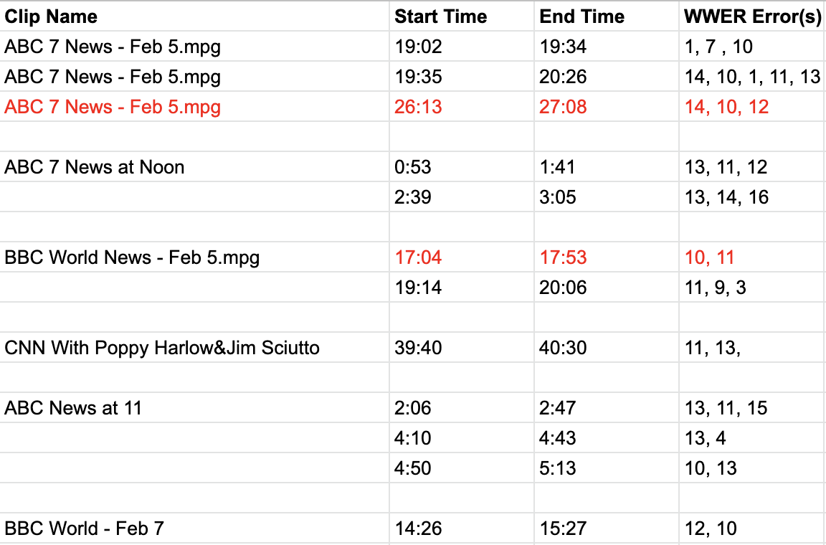
Test Clips List

Slide 5
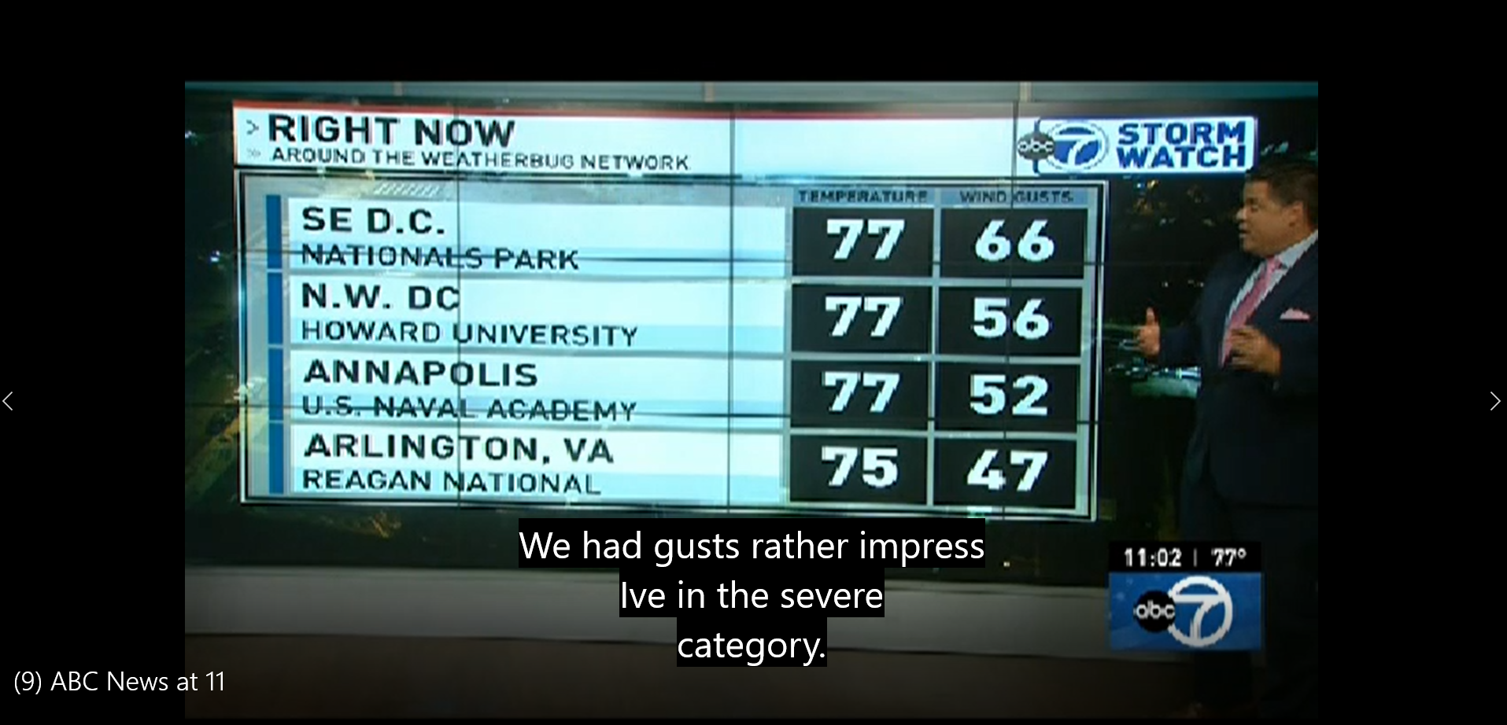
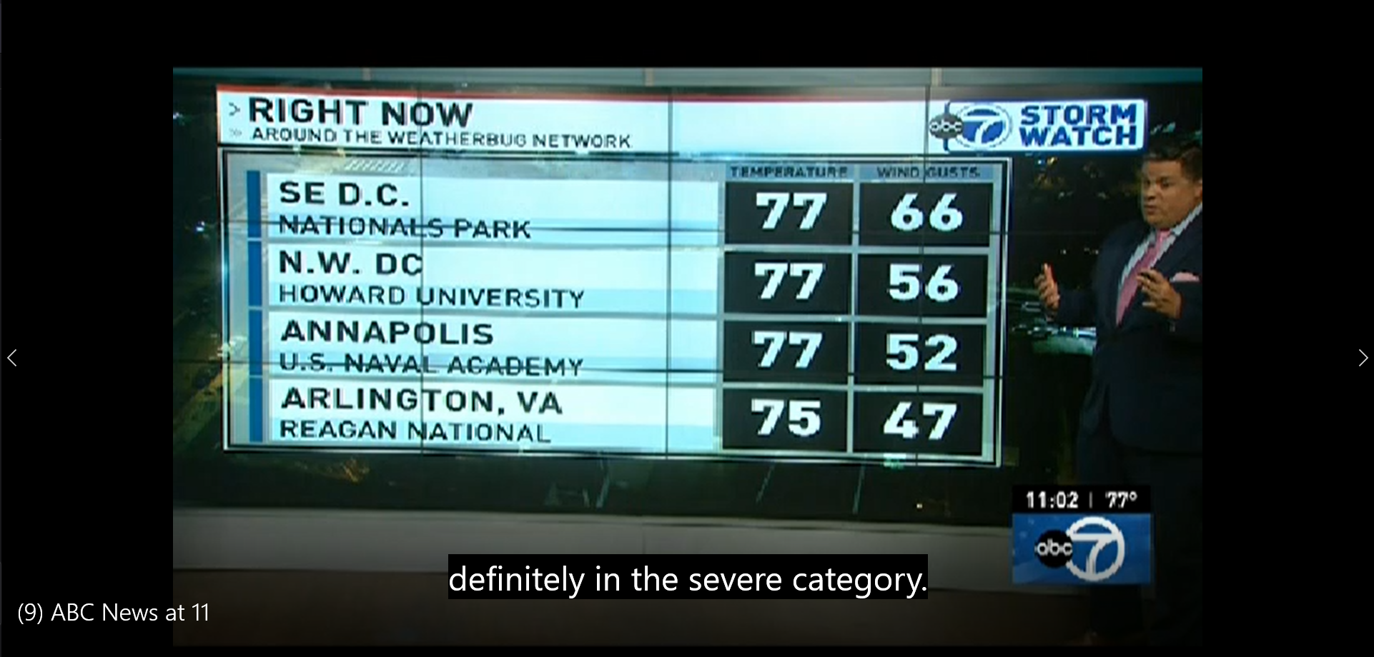
ERROR
ACCURATE

Slide 6
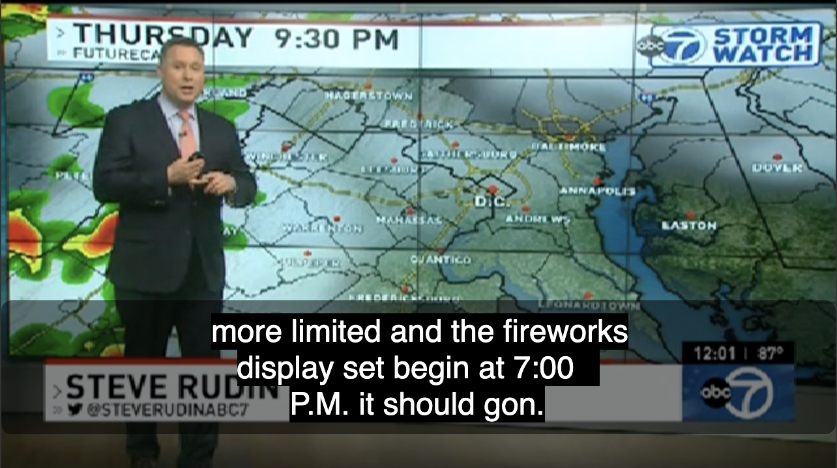
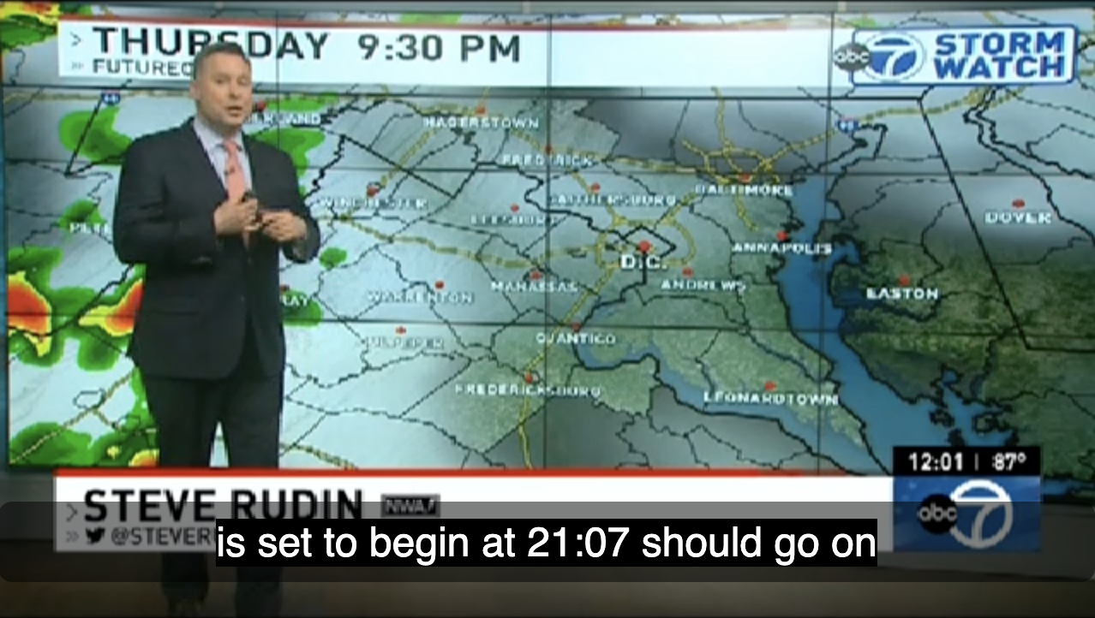
WWER Errors 13 (substitute wrong word) and 16 (word boundary error)
Error
Accurate

Slide 7
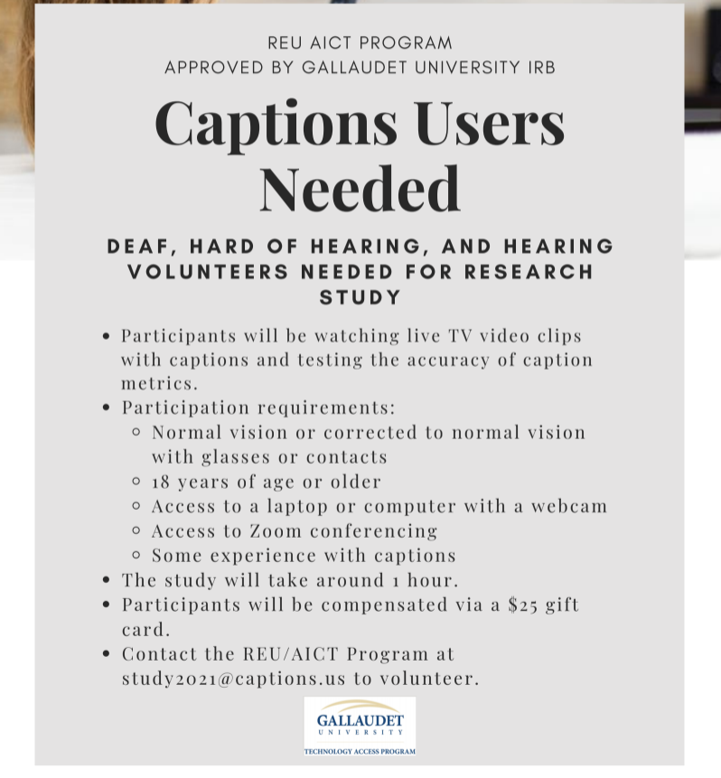
Participant recruitment
Participants will fill out an intake questionnaire regarding their demographics before meeting on Zoom

Slide 8
Some of our questions
Demographics
How would you rate your previous experiences with live TV or internet captioning?
1 - Very frustrating
5 - Very satisfied
What kinds of live programming do you watch with captions? (check all that apply)
News
TV shows
Social Media (e.g. Facebook Live, YouTube Live, Instagram, etc)

Slide 9
More of our questions
Post-test
First clip: How would you rate the quality of captions from 1-7?
1 - Poor
7 - Excellent
First clip: Did you notice any caption errors?
Yes
No
Comparing the original captions and accurate captions, how would you rate the differences between the two?
1 - Little difference
7 - Big change/difference

Slide 10
Our primary focus
Collect caption quality ratings comparing error and accurate clips. This will help us identify how users’ perceptions of quality affected by caption errors.
We will compare the user data with caption metric data (yet to be collected) and see which metrics most closely reflect user data.

